Slide 1
Coptic Lesson 15 Relative Pronouns

Slide 2
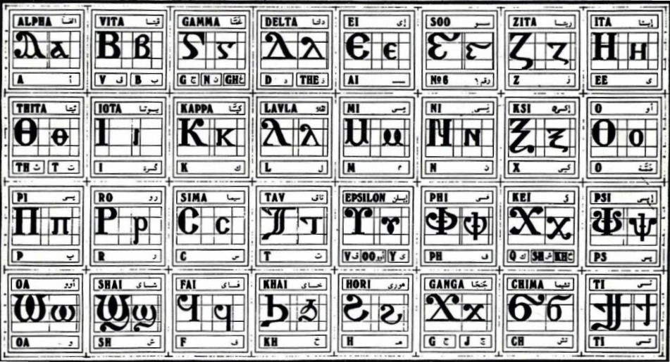
Coptic Alphabets

Slide 3
Review Questions
Coptic
Name
English
} ]
Tee
ti
b
Veeta
b, v
==e=;=u
E;ouab
Holy
=l=g
Map-somt
33
T t
Tav
t
U u
Epsilon
oo, ee, v
=,
coou-se
600

Slide 4
Rule for the Epsilon U
V
(after a>e)
U u =
oo
(after o - ou)
ee
(after constant, or with Jinkim`)
Examples:
mau
soury
humnoc
ouro
Eu`a
dumiany
`cnau

Slide 5
Coptic Bible Verses – Part 3
Rasi qen `P[oic `ncyou niben Rejoice in the Lord always. (Phil 4:4)
Twbh `ejen neten`eryou Pray for one another. (Jm 5:16)
Vnou] ouagapy pe God is love. (I Jn 4:16)
Jemnom] anok ai[ro `epikocmoc Be of good cheer, I have overcome the world. (Jn 16:33)
}ar,y `n]covia ]ho] `nte `P[oic te The fear of the Lord is the beginning of wisdom. (Ps 110:10)

Slide 6
Beginner Vocabulary Review
romi kahi `Vnou] `alou ioh
ry con syri iwt bal
yi ran ro ouro nyb
`chimi vorsi seri ourw ri
cwni ajp ve sau soury
mau ]`alou jij `;nyb hiomi
nicwni nirwmi niran nimau ni`alou
jom niourw nibal nisau ninyb
niseri totc io] ourwou vyou`i

Slide 7
Relative Pronouns
Vyet...
:yet...
Nyet...
Et...
who, which, that (masc.)
who, which, that (fem.)
who, which, that (plural)
may be substituted for above
t becomes ; before the letters
b i l m n o r

Slide 8
Exercise (Part 1)
Translate the following into English:
Vyethemci
He who sits
Pirwmi etaf`i
The man who came
:yetcaji
She who talks
}`chimi etachemci
The woman who sat
Nijom ethijem ]vorsi
The books that are on the table
Peniwt etqen nivyou`i.
Our Father Who is in the heavens.

Slide 9
Demonstrative Pronouns
Vyete`mmau
:yete`mmau
Nyete`mmau
Ete`mmau
that (masc.)
that (fem.)
those (plural)
may be substituted for above ("which is there")

Slide 10
Exercise (Part 2)
Translate the following into English:
Pirwmi vyete`mmau
That man
]`chimi ;yete`mmau
That woman
Ni`alwou`i nyete`mmau
Those boys

Slide 11
Announcement
All slides are available at http://www.ekladious.com/coptic.html

Slide 12

Oujai qen `P[oic

